Slide 1

MODULE OF OPERATING SYSTEM
Year I CS DAY
By Lecturer. Mr. Kwizera Jean Pierre
Copyright © 2006 by The McGraw-Hill Companies, Inc. All rights reserved.
McGraw-Hill Technology Education

Slide 2
Chapter 2: OPERATING SYSTEM CONCEPTS
INTRODUCTION
By Mr. Kwizera Jean Pierre

Slide 3
Introduction
An Operating System (OS) is an interface between a computer user and computer hardware.
An operating system is a software which performs all the basic tasks like file management, memory management, process management, handling input and output, and controlling peripheral devices such as disk drives and printers.

Slide 4
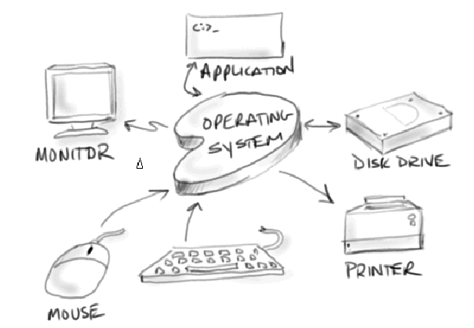
Operating System

Slide 5
FIRST QUIZ 17/03/2023
Describe why is Operating System is important / 3 marks
Explain the role of device driver
/ 3 marks
3. Describe any four applications of an Operating System / 4 marks

Slide 6
Five key concepts of operating system?
To understand clearly about an operating system, user need to know the five fundamental concepts of the operating system, which are the five tasks that an operating system can and will do.
The five tasks are:
Main memory Management,
Processor Management,
Device Management,
File Management, and
User Interface (A user interface (UI) refers to the part of an operating system, program, or device that allows a user to enter and receive information. )

Slide 7
Computer System Components
Hardware
  Provides basic computing resources (CPU, memory, I/O devices).
Operating System
  Controls and coordinates the use of hardware among application programs.
Application Programs
  Solve computing problems of users (compilers, database systems, video games, business programs such as banking software).
Users
  People, machines, other computers

Slide 8
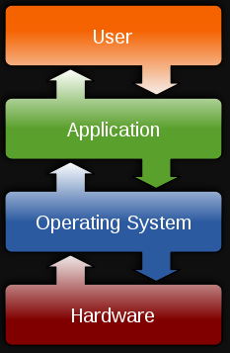
7B-<number>
Notes:
Teaching tip
OS X versions change often. Keep track of the most current and present this to the class. Visit www.apple.com/macosx/ to keep up to date. At press time the latest version was 10.4 Tiger.

Slide 9
Abstract View of System
User
1
User
2
User
3
User
n
...
System and Application Programs
compiler
assembler
Text editor
Database
system
Operating System
Computer
Hardware

Slide 10
Components of the Operating System
The operating system comprises a set of software packages that can be used to manage interactions with the hardware.
The following elements are generally included in this set of software:
Kernel
Shell
File system
7B-<number>

Slide 11
Components of the operating system
a) Kernel, which represents the operating system's basic functions such as management of memory, processes, files, main inputs/outputs and communication functionalities.
A kernel is the very core of a typical OS
Kernel is an active part of an OS i.e., it is the part of OS running at all times.
It is a programs which can interact with the hardware.
7B-<number>
Notes:
Teaching tip
OS X versions change often. Keep track of the most current and present this to the class. Visit www.apple.com/macosx/ to keep up to date. At press time the latest version was 10.4 Tiger.

Slide 12
Components of the operating system
b) Shell, allowing communication with the operating system via a control language, letting the user control the peripherals without knowing the characteristics of the hardware used, management of physical addresses, etc.
A shell allows all of its users to establish communication with the kernel.
It is an interface between user and kernel
Shell is called as the command interpreter.
It is a set of programs used to interact with the application programs.
It is responsible for execution of instructions given to OS (called commands)..
7B-<number>
Notes:
Teaching tip
OS X versions change often. Keep track of the most current and present this to the class. Visit www.apple.com/macosx/ to keep up to date. At press time the latest version was 10.4 Tiger.

Slide 13
Components of the operating system
c) File system, allowing files to be recorded in a tree structure.
In computing, a file system or filesystem (often abbreviated to fs) is a method and data structure that the operating system uses to control how data is stored and retrieved.
File system is the part of the operating system which is responsible for file management.
A file system is a method an operating system uses to store, organize, and manage files and directories on a storage device.
7B-<number>
Notes:
Teaching tip
OS X versions change often. Keep track of the most current and present this to the class. Visit www.apple.com/macosx/ to keep up to date. At press time the latest version was 10.4 Tiger.

Slide 14
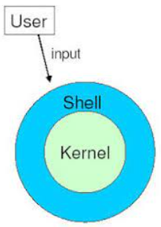

Components of the operating system
7B-<number>
Notes:
Teaching tip
OS X versions change often. Keep track of the most current and present this to the class. Visit www.apple.com/macosx/ to keep up to date. At press time the latest version was 10.4 Tiger.

Slide 15
Control Hardware Access
The operating system manages the interaction between applications and the hardware.
To access and communicate with the hardware, the operating system installs a device driver for each hardware component.
A device driver is a small program written by the hardware manufacturer and supplied with the hardware component.
When the hardware device is installed, the device driver is also installed, allowing the OS to communicate with the hardware component.

Slide 16
The process of assigning system resources and installing drivers can be performed with Plug and Play (PnP).
The PnP process was introduced in Windows 95 to simplify the installation of new hardware.
All modern operating systems are PnP-compatible. With PnP, the operating system automatically detects the PnP-compatible hardware and installs the driver for that component.

Slide 17
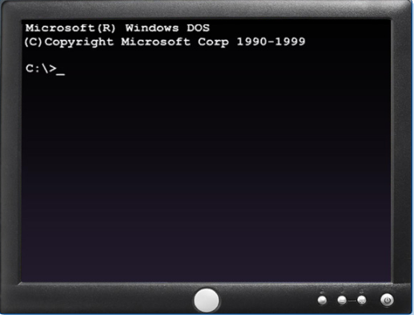
User Interface
The operating system enables the user to interact with software and hardware.
There are two types of user interfaces:
Command Line Interface (CLI) – The user types commands at a prompt, as shown in Figure 1.

Slide 18
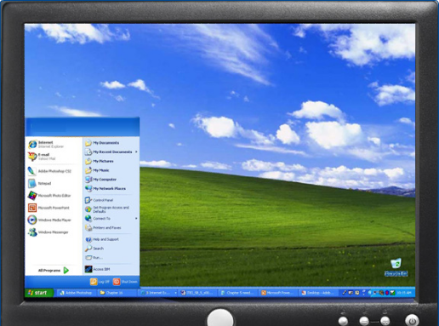
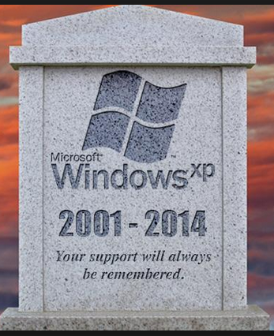
Graphical User Interface (GUI) – The user interacts with menus and icons, as shown in Figure.
All good things must come to an end, even Windows 7. After January 14, 2020, Microsoft will no longer provide security updates or support for PCs running Windows 7. But you can keep the good times rolling by moving to Windows 10.

Slide 19
Application Management
The operating system locates an application and loads it into the RAM of the computer.
Applications are software programs, such as word processors, databases, spreadsheets, games, and many other applications.
The operating system ensures that each application has adequate system resources.
Application programming interface (API) is a set of guidelines used by programmers to ensure that the application they are developing is compatible with an operating system.

Slide 20
Explain operating system concepts
To understand the capabilities of an operating system, it is important to understand some basic terms. The following terms are often used when comparing operating systems:
Multi-user – Two or more users can work with programs and share peripheral devices, such as printers, at the same time.
b) Multi-tasking – The computer is capable of operating multiple applications at the same time.
c) Multi-processing – The computer can have two or more central processing units (CPUs) that programs share.

Slide 21
Multi-threading – A program can be broken into smaller parts that can be loaded as needed by the operating system. Multi-threading allows individual programs to be multi-tasked.
Almost all modern operating systems are multi-user and multi-tasking, and they support multi-processing and multi-threading.

Slide 22
Describe and compare operating systems to include purpose, limitations, and compatibilities
A technician may be asked to choose and install an operating system for a customer. The type of OS selected depends on the customer's requirements for the computer. There are two distinct types of operating systems: desktop operating systems and network operating systems.
A desktop operating system (DOS)is intended for use in a small office/home office (SOHO) with a limited number of users.
A network operating system (NOS) is designed for a corporate environment serving multiple users with a wide range of needs.

Slide 23
Describe desktop operating systems
A desktop OS has the following characteristics:
Supports a single user
Runs single-user applications
Shares files and folders on a small network with limited security
In the current software market, the most commonly used desktop operating systems fall into three groups:
Microsoft Windows,
Apple Mac OS, and
UNIX/Linux and Android
Notes:
http://www.jide.com/remixos
Release date: November 25, 2016
http://www.jide.com/remixos
http://www.jide.com/remixos-for-pc#downloadNow
http://www.jide.com/remixos-for-pc#downloadNow

Slide 24
These are the most common network operating systems:
Microsoft Windows – Network operating systems offered by Microsoft are Windows Server 2000, Windows Server 2008, and Windows Server 2003. Windows Server operating systems use a central database called Active Directory to manage network resources.
Apple- Mac OS
Linux – Linux operating systems that includes:
- Red Hat, Caldera, SuSE, Debian, and Slackware,Cent OS.
UNIX – Various corporations offered proprietary operating systems, based on UNIX.
Android – For mobile and for PC (Remix OS)

Slide 25
Install an operating system
As a technician, you may have to perform a clean installation of an operating system.
Perform a clean install in the following situations:
When a computer is passed from one employee to another
When the operating system is corrupted
When a new replacement hard drive is installed in a computer

Slide 26
Identify hard drive setup procedures
The installation and initial booting of the operating system is called the operating system setup.
Although it is possible to install an operating system over a network from a server or from a local hard drive, the most common installation method is with CDs and DVDs.
To install an OS from a CD or DVD, first configure the BIOS setup to boot the system from the CD or DVD.
Notes:
Lab1: Deployment of an OS or a software from a server
- Operating system upgrade

Slide 27
Partitioning and Formatting
Before installing an operating system on a hard drive, the hard drive must be formatted and partitioned.
NB. When a hard drive is partitioned, it is logically divided into one or more areas.
When a hard drive is formatted, the partitions are prepared to hold files and applications.
A technician should understand the process relating to hard drive setup.

Slide 28
Before installing an operating system and software, users need to format the hard disk.
And then, they can use the hard disk to store all kinds of information.
Many people may think that they need to divide a hard disk into several partitions.
In fact, users can create only one partition using all or part of the hard disk space. However, no matter how many partitions users divide the disk into.

Slide 29
Reason for Partitioning Hard Disk
In general, each notebook users bought only contains a drive C.
When the system needs to be restored, the entire drive C (it is the system disk) will be formatted. Thus, all information saved in the system disk will be lost.
Saving massive information on system partition will slow down the computer.
Different types of data should be saved in different partitions.

Slide 30
The following terms are used when referring to hard drive setup:
Primary partition: This partition is usually the first partition. A primary partition cannot be subdivided into smaller sections.
Primary partition is a relatively simple partition which is usually located in the top of hard disk area to constitute the logical C disk.

Slide 31
b) Active Partition
Active partition: This partition is the partition used by the operating system to boot the computer. Only one primary partition can be marked active.
In every operating system, the hard disk must have at least one partition marked as an active partition.
The computer's basic input/output system (BIOS) uses the active partition to load the operating system.
In most desktops and servers, this partition is normally the hard disk's C: drive.

Slide 32
  c) Extended partition: This partition normally uses the remaining free space on a hard drive.
  There can be only one extended partition per hard drive, and it can be subdivided into smaller sections called logical drives.
  d) Logical drive: This drive is a section of an extended partition that can be used to separate information for administrative purposes.

Slide 33
  Formatting: This process prepares a file system in a partition for files to be stored.
  A partition, or disk partition, is a logical division on a hard disk drive (HDD) that enables a PC to have different drives.
  Drive mapping: Drive mapping is a letter assigned to a physical or logical drive.

Slide 34
Booting of a Computer System

Slide 35
Booting
Booting is basically the process of starting the computer.
When the CPU is first switched on it has nothing inside the Memory.
To boot (to boot up, to start up or booting) a computer is to load an operating system (OS) into the computer's main memory or RAM.
In order to start the Computer, load the Operating System into the Main Memory and then Computer is ready to take commands from the User. Learn the types of booting.

Slide 36
Why is Booting Required ?
Once the OS is loaded (for example, on a PC, you will see the initial Windows or Mac desktop screen), it's ready for users to run applications.

Slide 37
Why is Booting Required ?
Hardware doesn’t know where the operating system resides and how to load it.
Need a special program to do this job – Bootstrap loader.
  E.g. BIOS – Basic Input Output System.
Bootstrap loader locates the kernel, loads it into main memory and starts its execution.
In some systems, a simple bootstrap loader fetches a more complex boot program from disk, which in turn loads the kernel.

Slide 38
Bootstrap
"Boot" is short for "bootstrap,"
The BIOS will try to initiate the boot sequence from the first device.
If the BIOS does not find a device, it will try the next device in the list.
If it does not find the proper files on a device, the startup process will halt.

Slide 39
Types of Booting
There are two types of booting:
Cold Booting
A cold boot is also called a hard boot. It is the process when we first start the computer.
In other words, when the computer is started from its initial state by pressing the power button it is called cold boot. The instructions are read from the ROM and the operating system is loaded in the main memory.

Slide 40
b) Warm Booting
Warm Boot is also called soft boot. It refers to when we restart the computer.
Here, the computer does not start from the initial state. When the system gets stuck sometimes it is required to restart it while it is ON.
Therefore, in this condition the warm boot takes place.
Restart button or CTRL+ALT+DELETE keys are used for warm boot.

Slide 41
Tasks performed at boot up
On finding a bootable device, the BIOS loads and executes its boot sector. In the case of a hard drive, this is referred to as the Master Boot Record (MBR) and is often not OS specific.
The MBR code checks the partition table for an active partition. If one is found, the MBR code loads that partition's boot sector and executes it.
The boot sector is often Operating System specific, however in most operating systems its main function is to load and execute a kernel, which continues startup.

Slide 42
Tasks performed at boot up (Cont’d)
What are the 6 stages of the boot process?
is a process of switching on the computer and starting the operating system.
Six steps of the booting process are:
Startup
BIOS: Power On Self Test
Load of OS,
System Configuration,
System Utility Loads and
Users Authentication.

Slide 43
Steps of Booting
We can describe the boot process in six steps:
1. The Startup
It is the first step that involves switching the power ON. It supplies electricity to the main components like BIOS and processor.
2. BIOS: Power On Self Test
It is an initial test performed by the BIOS. Further, this test performs an initial check on the input/output devices, computer’s main memory, disk drives, etc. Moreover, if any error occurs, the system produces a beep sound.

Slide 44
3. Loading of OS
In this step, the operating system is loaded into the main memory. The operating system starts working and executes all the initial files and instructions.
4. System Configuration
In this step, the drivers are loaded into the main memory. Drivers are programs that help in the functioning of the peripheral devices.

Slide 45
5. Loading System Utilities
System utilities are basic functioning programs, for example, volume control, antivirus, etc. In this step, system utilities are loaded into the memory.
6. User Authentication
If any password has been set up in the computer system, the system checks for user authentication. Once the user enters the login Id and password correctly the system finally starts.

Slide 46
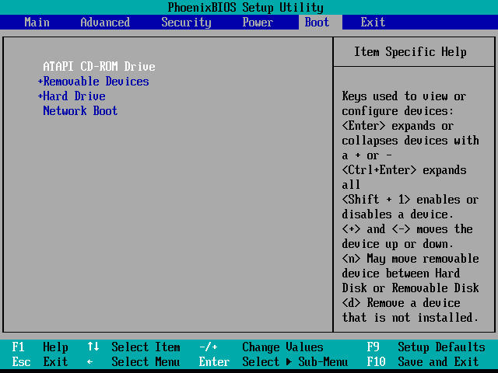
BIOS Setup

Slide 47
End of Chapter 2
Thank you for your kind attention,
May God bless all of you
By Mr. Kwizera Jean Pierre

